Slide 1
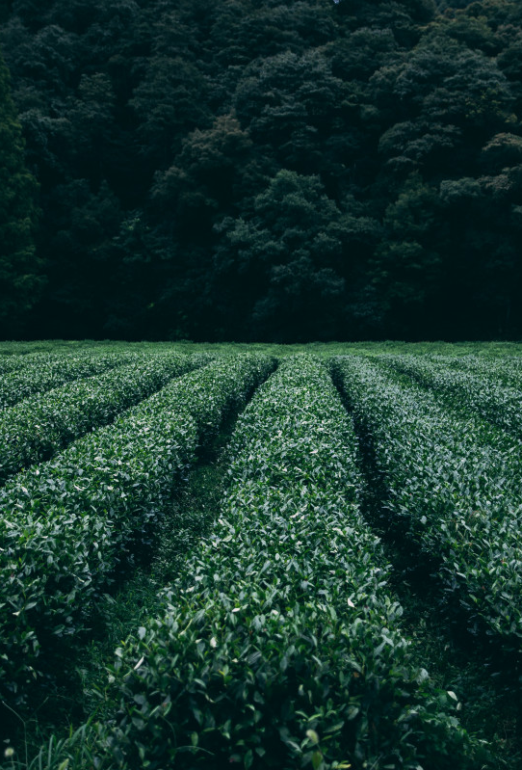
Food For Thought: A Network Analysis of Supermarket Ingredients, a visualization of our food system, and a guide to understanding what we are consuming
Presented by Samuel Oliveira

Slide 2
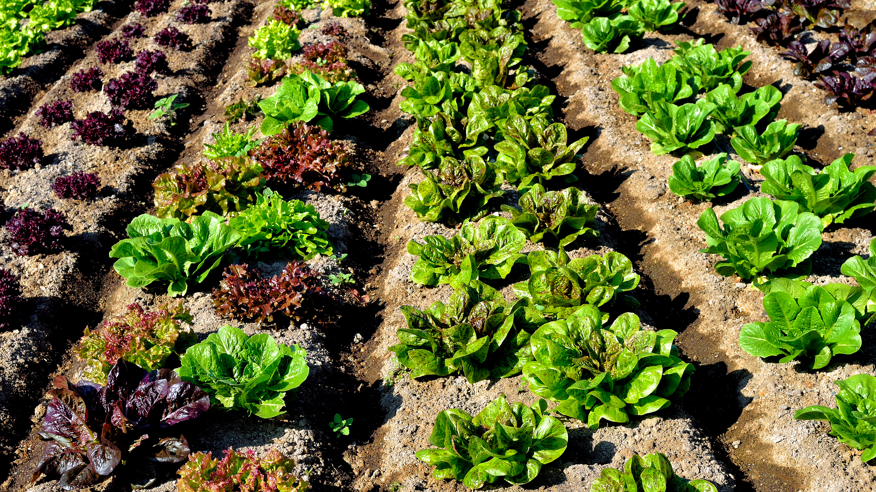

Slide 3
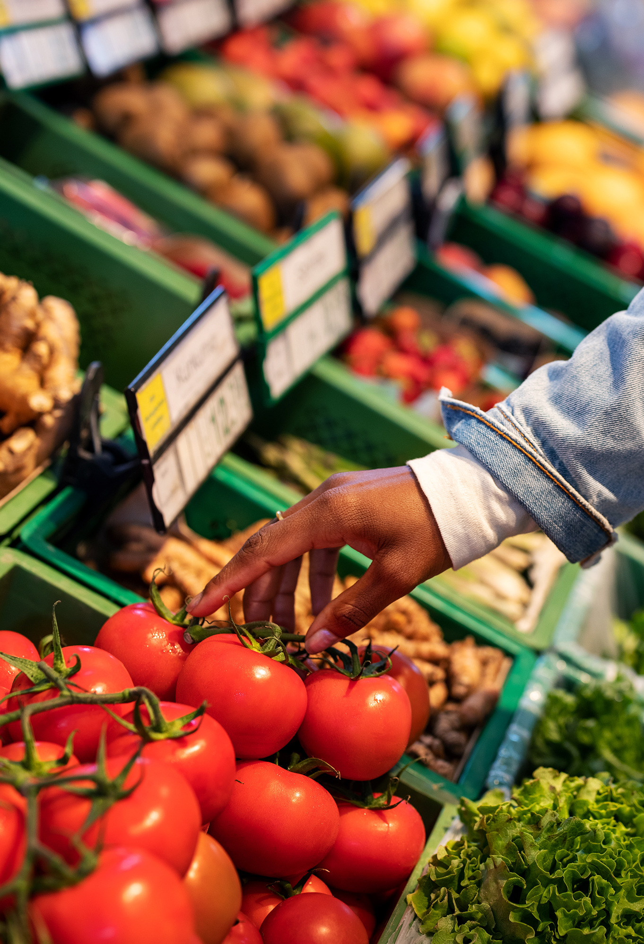
Today's Agenda
Introduction
Historical Context
Methodology
Construction & Statistics
Network Measures
Conclusion
Please feel free to ask any questions during the presentation

Slide 4
Introduction & Motivation
“In the age of industrial food, eating is an act of trust.” ~ Eric Schlosser
“Tell me what you eat, and I will tell you what you are.” ~ Jean Anthelme Brillat-Savarin

Slide 5

The History of Processed Foods
Rise of Processed Foods
The development of food processing machinery marks the beginning of a new dietary era
Convenience is King
Social proclivities select foods for their convenience rather than their health and fresh sourcing
Diet Obfuscation
We are left with a poor understanding of how our foods are made and what they contain

Slide 6
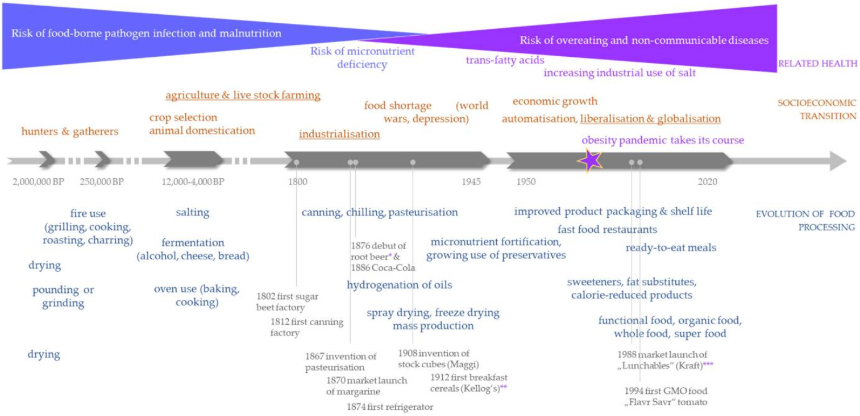
https://pmc.ncbi.nlm.nih.gov/articles/PMC7466326/

Slide 7

Expectations and Potential Insights
Understanding of the most common active ingredients in an American Diet
Visualization of the 'hidden' ingredients in our dietary network
Ability to trace back our foods and diets to their source
Information on what are the major corporations that provide us with the food we eat

Slide 8

Data Collection & Methodology
Data Collection
To collect the data for ingredients in foods and their connections, I used a database from USDA Food-Data Central. Data collection is changing with the emergence of artificial intelligence. With these new tools at our disposal, I wanted to experiment with the power of a Claude-Developed web-scraper. So that I could collect enough data to have some definitive results.
Methodology
The nodes in this graph are ingredients in foods.
The edges between any two ingredients mean that they show up in a food together. The edges are weighted (the weight will be how many times that pair shows up in the set of foods)
The graph and the its measures were built and calculated by with Gephi. Excel was used for formatting the data.

Slide 9
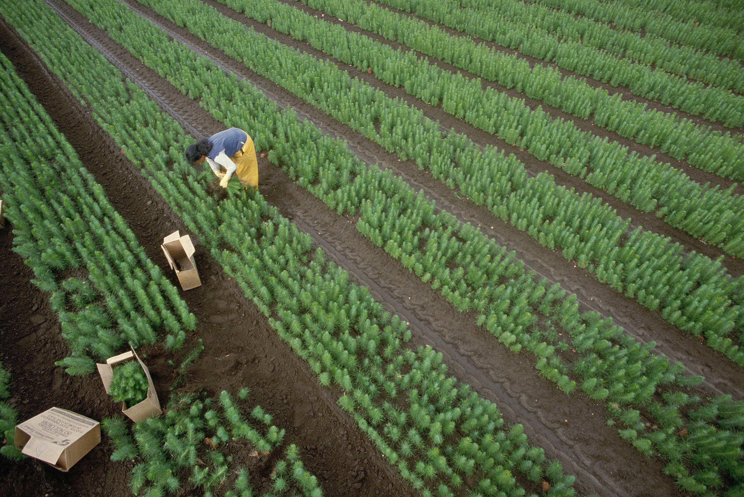
The Graph
Let's analyze

Slide 10
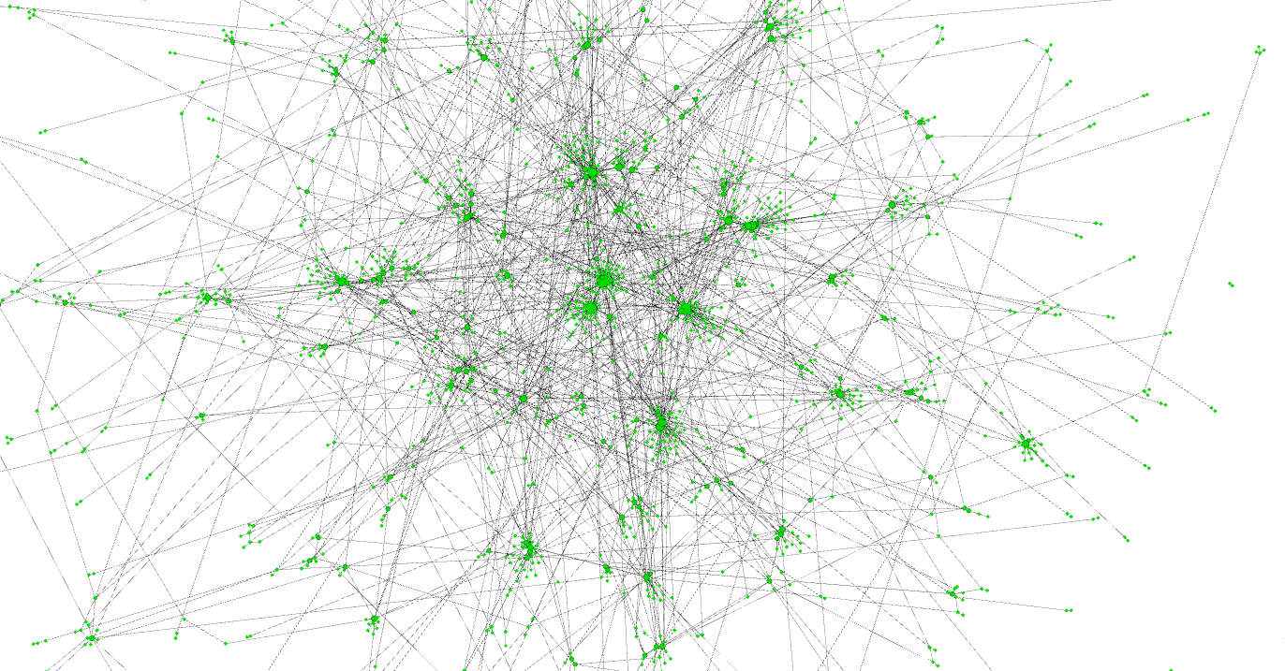
1966 Nodes!
2297 Edges!

Slide 11
Soybean Oil
Dextrose
Folic Acid
Milk
Yeast
Vegetable Oil
Wheat Flour
Salt
Citric Acid
Modified Food Starch
Artificial Flavor
Water
Sugar
Colorants
Niacin
Spice
Caramel Color
1966 Nodes!
Corn Starch
2297 Edges!
Reduced Iron & Mono-diglycerides
Guar-Gum

Slide 12
Global Graph Measures:
Number of Nodes: 1966
Number of Edges: 2297
Average Degree: 2.337 (small world)
Average Weighted Degree: 7.046
Network Diameter: 16
Graph Density: 0.001
Connected Components / Cliques: 136
Modularity: 0.842
Average Path Length: 5.881

Slide 13
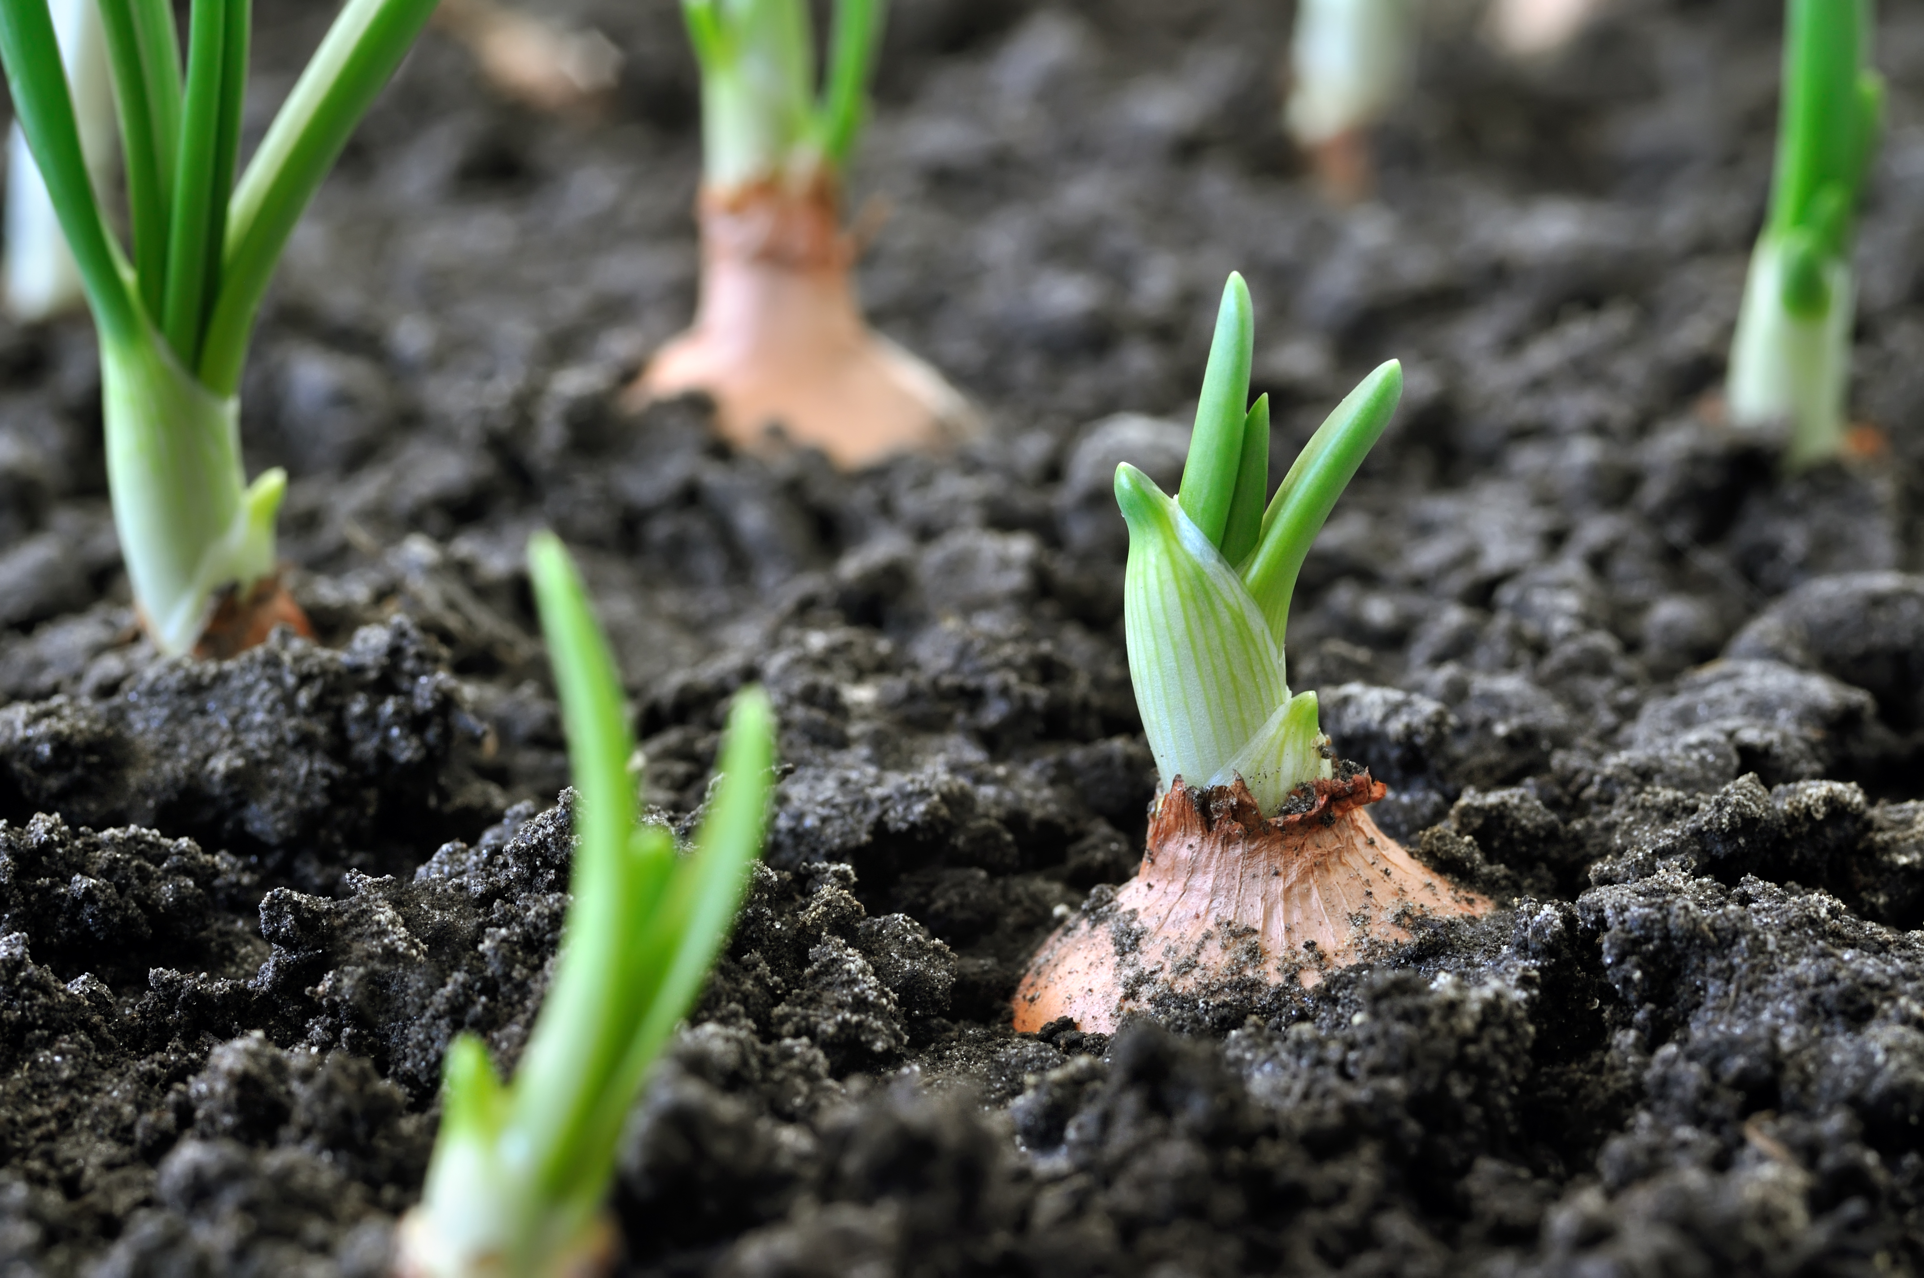
Node Specific Measures

Slide 14
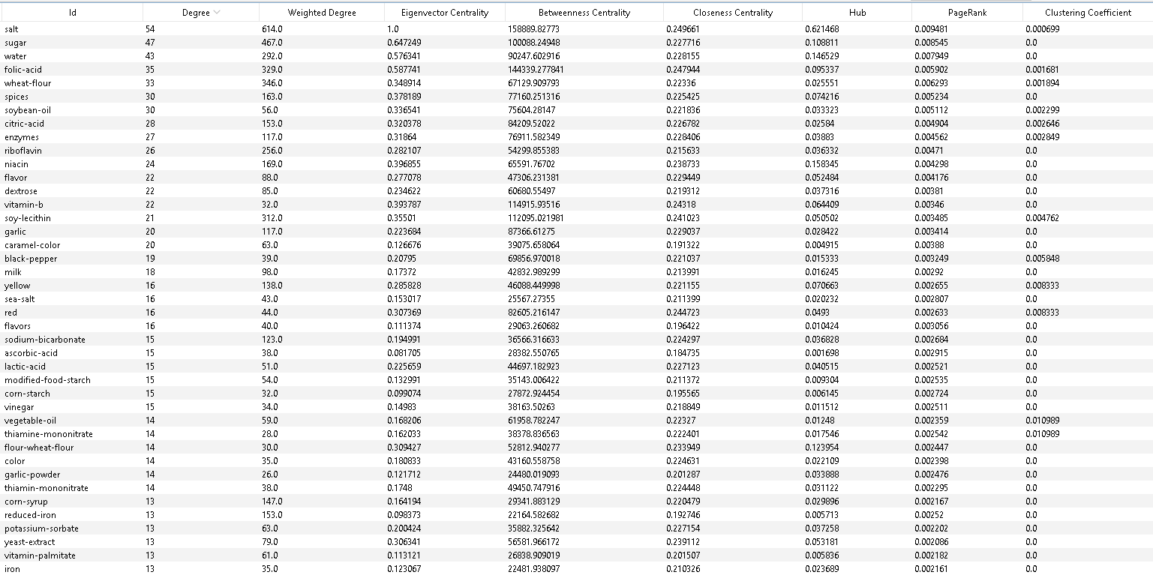
General Overview

Slide 15
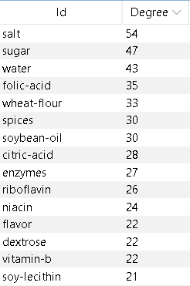
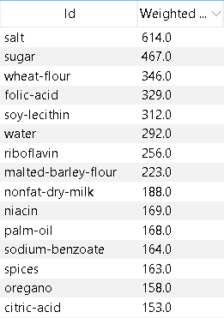
Degree Centrality
These are the top 15 nodes in terms of degree centrality and weighted degree centrality
Note the difference between Degree centrality and Weighted Degree centrality
Degree centrality shows the size of the range of ingredients one ingredient can match with
Weighted Degree centrality shows how many different foods that ingredient is a part of
Swaps in the lists demonstrate how some ingredients are used in less contexts, but more frequently and vice versa

Slide 16
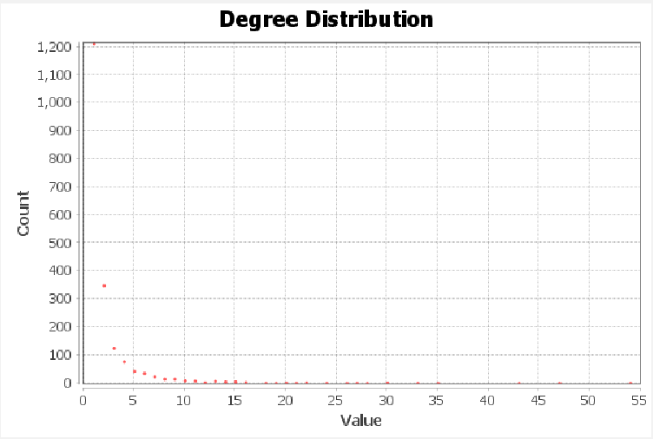

Slide 17
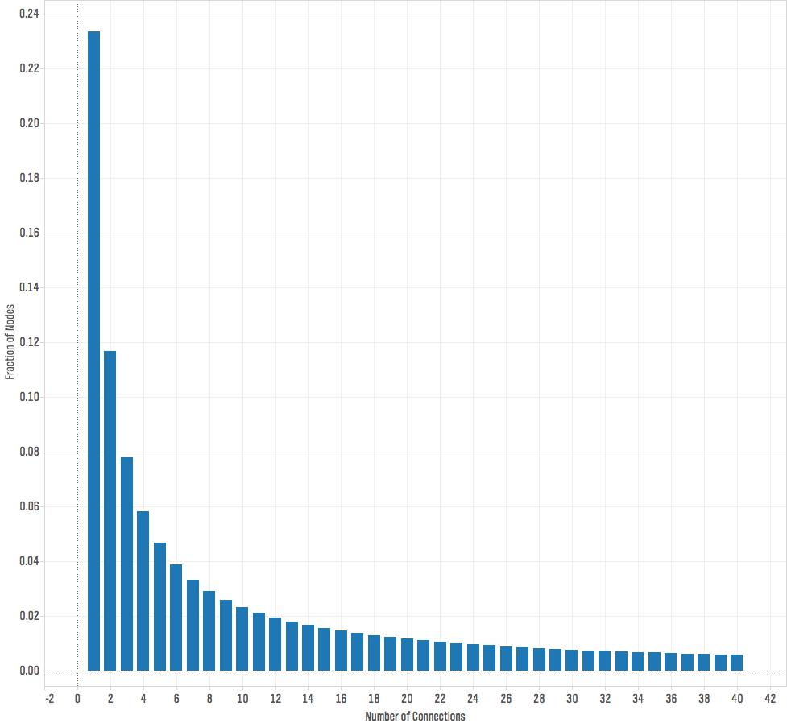
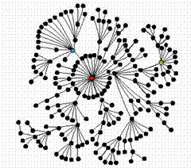

Slide 18
1966 Nodes!
2297 Edges!

Slide 19
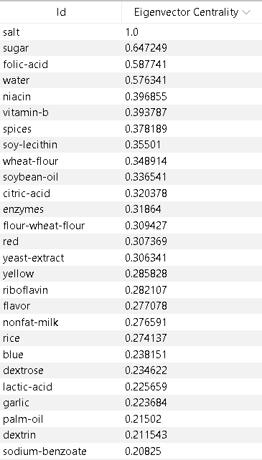
Eigenvalue Centrality
Note: Salt has an eigenvalue centrality of 1!!
With eigenvalue centrality, we can truly see which nodes are of maximum importance since the ranking is based on connection importance
This means that the top ingredients in this list are both used frequently, and in the most foods as well. The ranking is a middle ground for what we say in the degree centrality rankings
The top four nodes, (salt, sugar, folic acid, and water), co-exist in the majority of foods

Slide 20
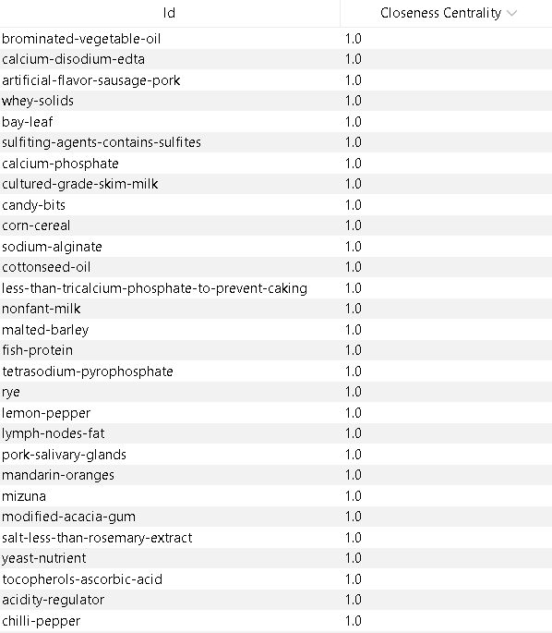
Closeness Centrality
These ingredients are the closest on average to the other nodes around them. (the values of closeness centrality have been normalized)
Even though these ingredients can reach other ingredients around them in a few steps, this does not really imply anything too important about our food structure
The nodes listed are universal in their use cases. Even though they may not be common, they are able to connect the food world together
They may represent the links between different types of foods as they can be universally used.
Note: Commonly used ingredients appear in hubs as many recipes use very similar ingredients

Slide 21
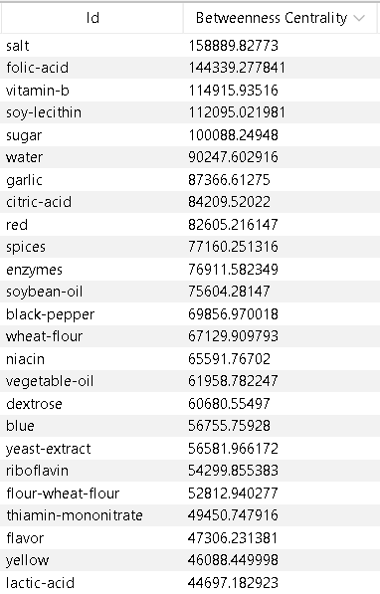
Betweenness Centrality
Betweenness centrality demonstrates a more intuitive way of measuring closeness
Instead of seeing how close an ingredient is to others, we see how useful an ingredient is in creating links with other sections of the graph.
These ingredients will represent the ingredients that most commonly match two or more different types of foods
The presence of processed ingredients is higher in this list, and the rankings seem to prefer processed foods as well.
Processed foods provide a culinary bridge

Slide 22
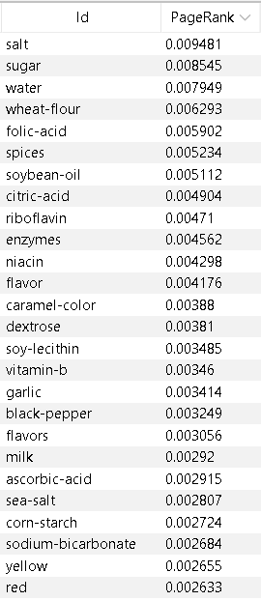
Page Rankings
Page rank will measure the weighted probability of an ingredient being used in any given food
This list is a guide to the most "generally used" foods in an average supermarket.
If you were to walk through a supermarket and look through the ingredients, there is a high probability that a few of these ingredients will be listed.
Processed ingredients seem to be a common theme in page rank
Note that many of these ingredients show up in out degree centrality and betweenness centrality rankings as well

Slide 23
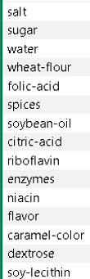
Comparisons Between Measures
Guide
Degree
Weighted
Eigenvector
Betweenness
Page Rank
Degree
Rank by number of unique foods it is used in
Weighted
Rank by total number of foods it is used in
Eigenvector
Rank by co-usage with other important ingredients
Betweenness
Rank by the number of links it provides between various groups of foods (shortest paths)
Page Rank
Rank by probability of actual usage (referenced by other ingredients in some food)

Slide 24
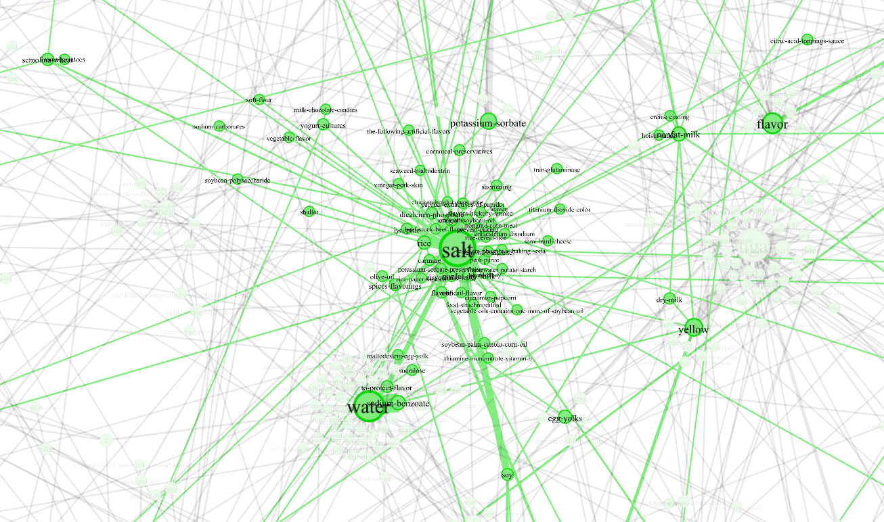
1.5 Ego Networks

Slide 25
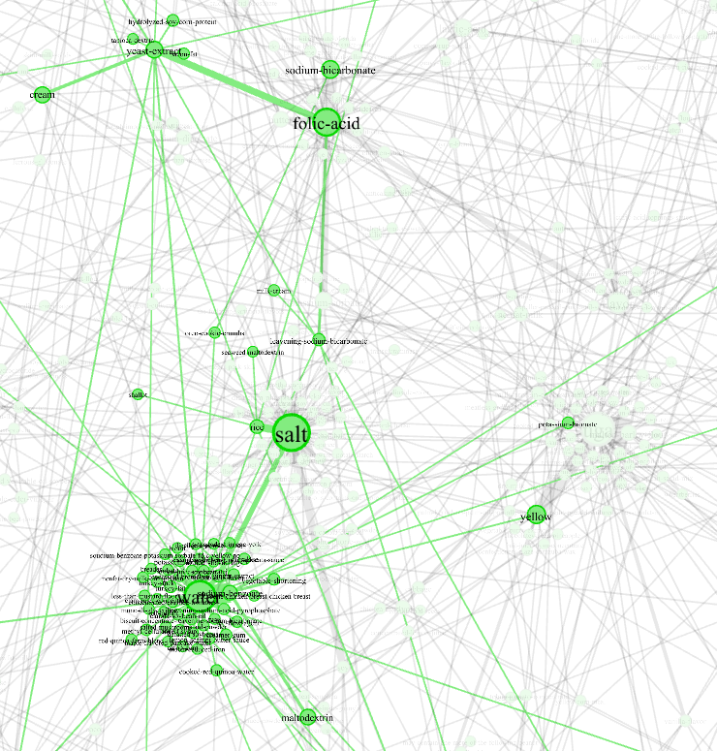
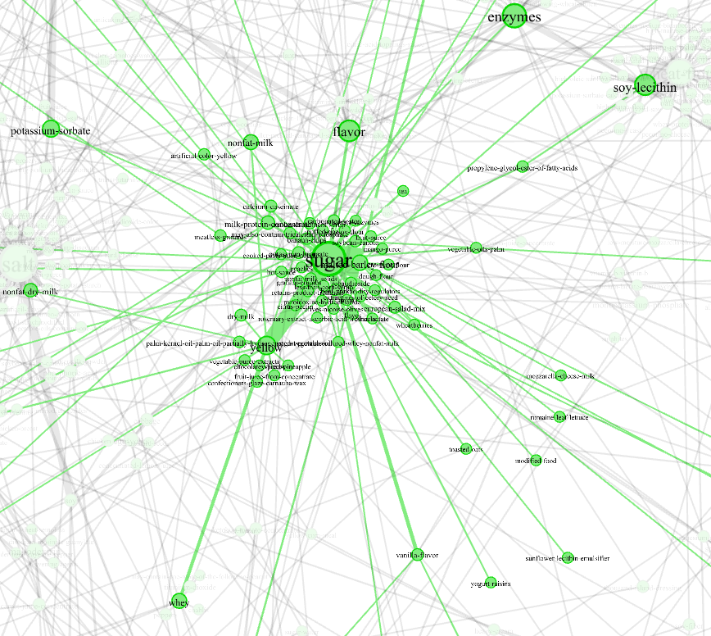
1.5 Ego Networks

Slide 26
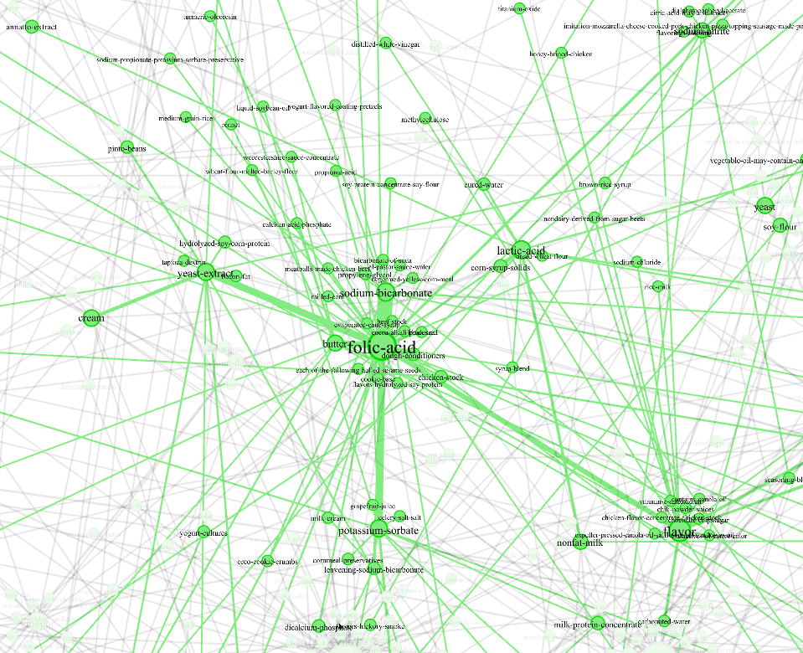
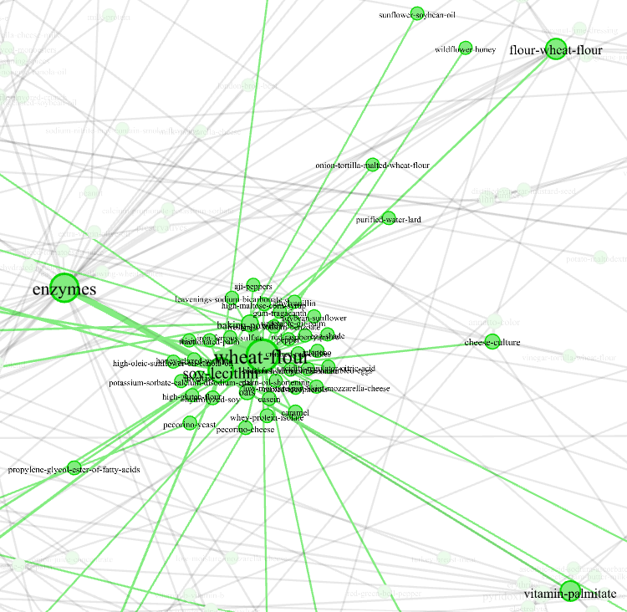
1.5 Ego Networks

Slide 27
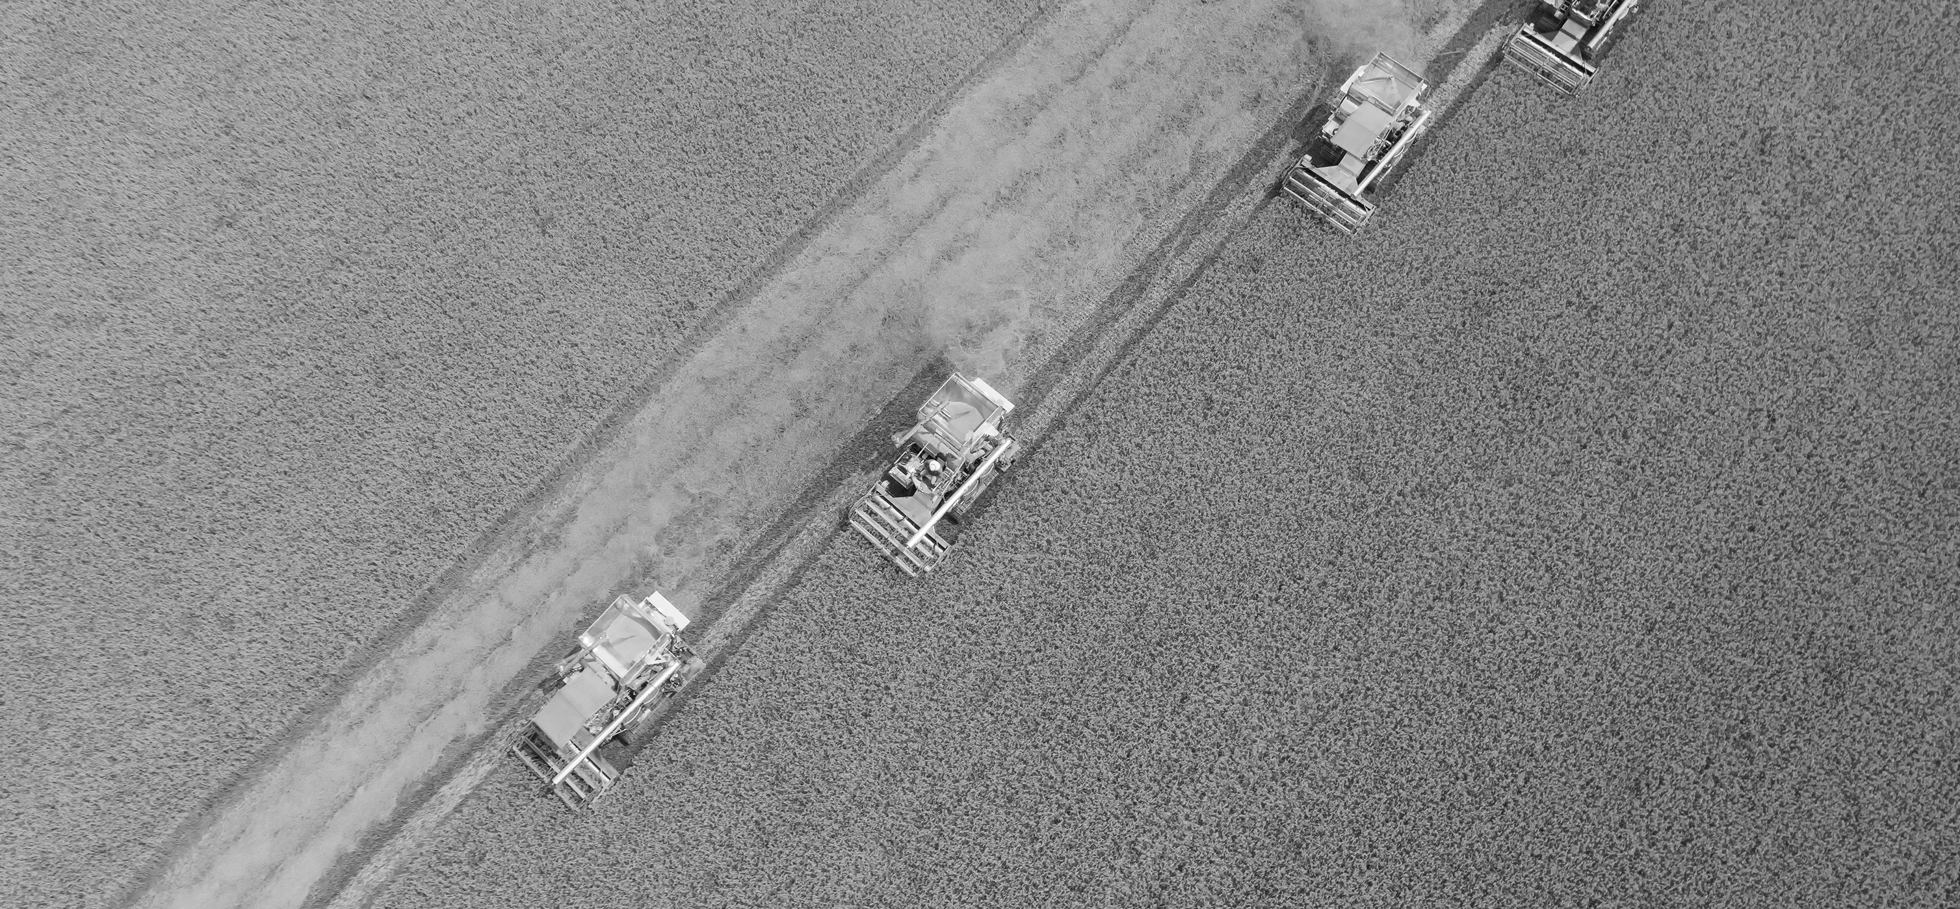

Conclusions & Implications

Slide 28

Are Processed Foods Inevitable?
In many of the rankings, processed foods dominate the twenty nodes.
Sugar: Top 2 in 3 rankings, Top 5 in 1 ranking
Folic Acid: Top 5 in 4 rankings
Soy-based Products: Top 10 in 4 rankings
Dyes (Red, Yellow): Top 15 in 3 Rankings
Even without disregarding some non-negotiable ingredients such as salt and water, processed foods still dominate the top 5-15 ingredients used

Slide 29
Are Processed Foods Inevitable?
The network reveals a shift from an ingredient society to a grocery store society. High modularity (0.842) imply that traditional ingredient communities still exist. Low density and strong hubs show a few global ingredients dominating across many foods, many of which are processed. The small-world structure demonstrates how processing connects nearly all ingredients within a few steps despite the low average degree measure. Our food system shows the results of cultural globalization and the push for convenience.
Small-World Network
Scale Free Network
Numerical validation on the quantity of processed foods

Slide 30
Thank You!
Presented by Samuel Oliveira
Please feel free to ask any questions

Slide 31
Citations
https://pmc.ncbi.nlm.nih.gov/articles/PMC7466326/ - Food Ingredients Data
https://claude.ai/ - Web Scraper Template
Gephi - The Open Graph Viz Platform - Graph Design

Slide 32
Food For Thought: A Network Analysis of Supermarket Ingredients, a visualization of our food system, and a guide to understanding what we are consuming
Presented by Samuel Oliveira

